Slide 1
HOSPITALIZATION-DAYS-PREDICTION
A system that predicts the duration of hospitalization required with an aim to prevent unnecessary hospitalizations, thereby saving expenditure on healthcare per capita.

Slide 2
PROBLEM STATEMENT
Studies have concluded that in 2006 well over $30 billion was spent on unnecessary hospital admissions. Is there a better way?
Can we identify those most at risk earlier and ensure they get the treatment they need?
To achieve its goal of developing a breakthrough algorithm that uses available patient data to predict and prevent unnecessary hospitalizations.

Slide 3
OBJECTIVES
Times of recession and increase in healthcare expenses after the pandemic - utmost importance.
To cut down expenditure on healthcare as well as minimizing the number of hospitalizations.
Result: Less crowding in hospitals
Bearing in mind precautionary measures in lieu of the pandemic.
Minimize the expenditure of people and government on healthcare.

Slide 4
METHODOLOGY
The problem statement has been solved by regression in this project.
This project needs rigorous data preprocessing which was a required step as a result of the nature of given dataset.
The provided database comprised of 13 files in csv format.
As a team, we initially gathered our understanding of the given data and the required output, followed by the eventual design of the system.

Slide 5
About the Project
Data Preprocessing:
This was the most crucial part of the design as data was very haphazard.
For null values in the data, we found their proportion to be quite less for the most important/influential input features.
As a result, their replacement with zero didn’t have much effect on the final classification accuracy.
This was followed by handling of missing and inconsistent data.
We did one-hot encoding for handling categorical features.

Slide 6
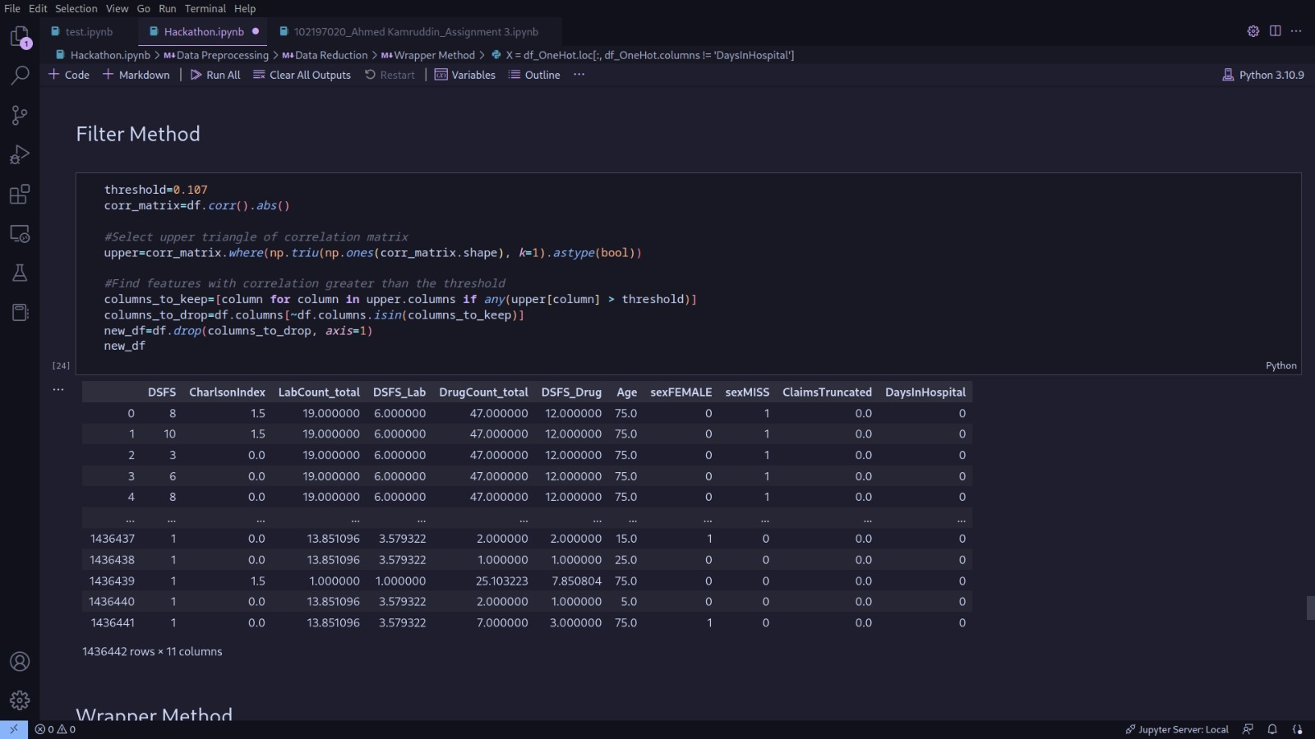
Data reduction-Filter Method

Slide 7
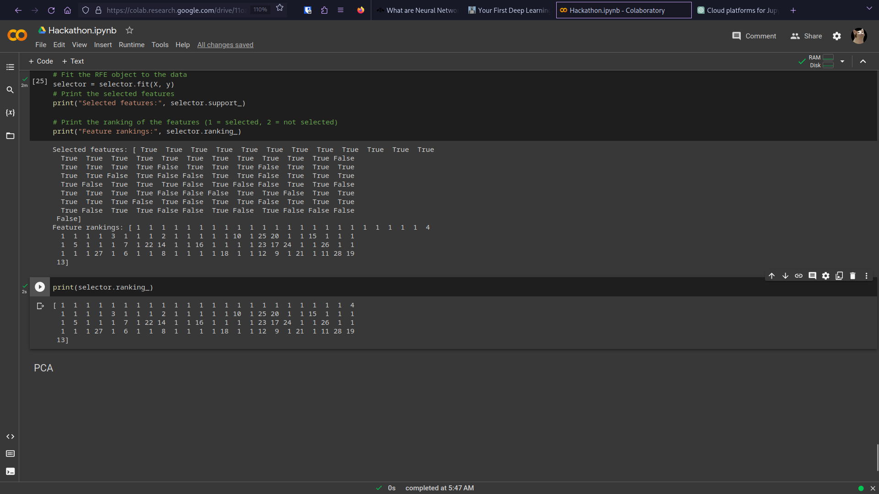
Data Reduction- Wrapper Method

Slide 8
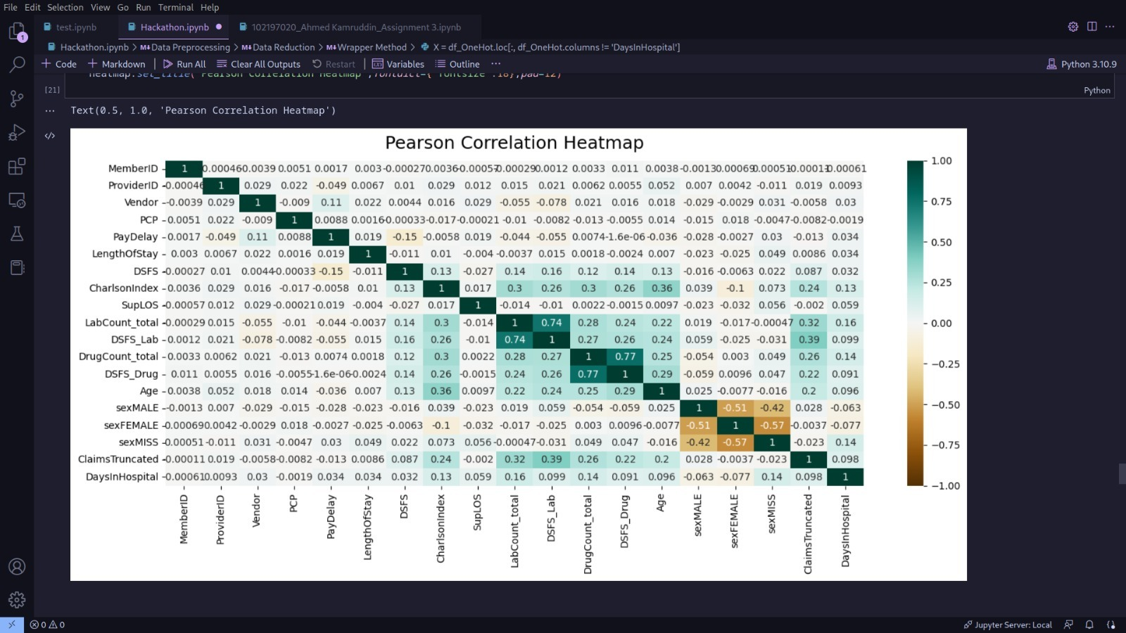
Data Reduction- Pearson Correlation Map

Slide 9
Feature Selection and Extraction
The original dataset had 102 features.
We initially found correlation coefficient between the output feature and all input features
After preprocessing, we found the most important features through filter method.
We then applied random forest classifier for ranking features in descending order of their importance.
This was followed by wrapping method on the data, which gave the final array of features advised to be kept in the dataset.
We the selected 70 most important features from the data.
This was followed by dimensionality reduction via Principal Component Analysis (PCA).

Slide 10
Data Modelling:
To create a prediction model, we used the approach of classification models for categorical data and regresssion models for numerical data.
We compared different classification models and found decision tree classifier to be the most accurate of them all.
We compared different regression models and found Gradient Boosting Model to be the most accurate of them all.
We then ensembled these two models for increasing the final performance of the model.

Slide 11
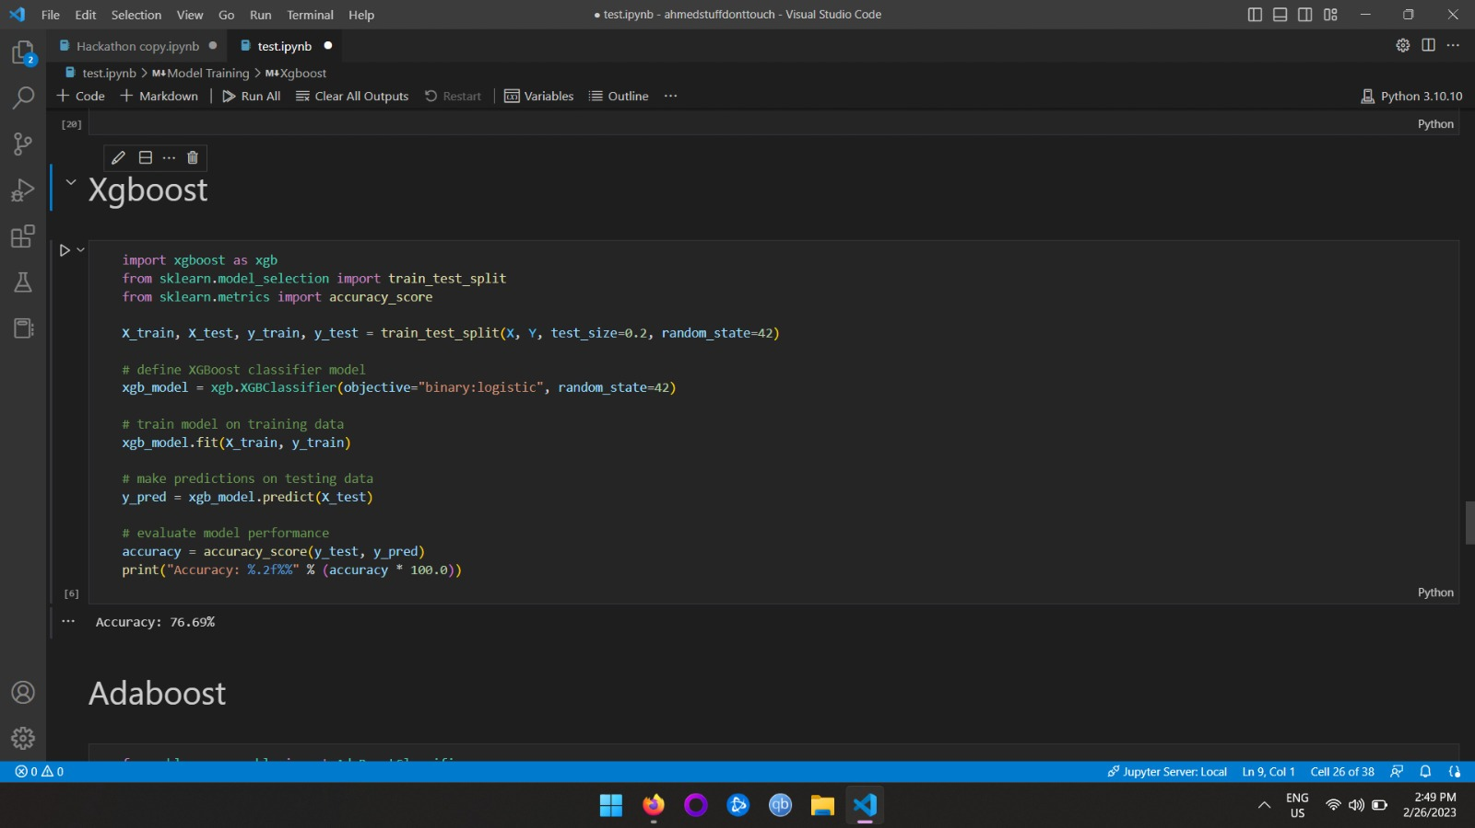
Classifier Model-XgBoost

Slide 12
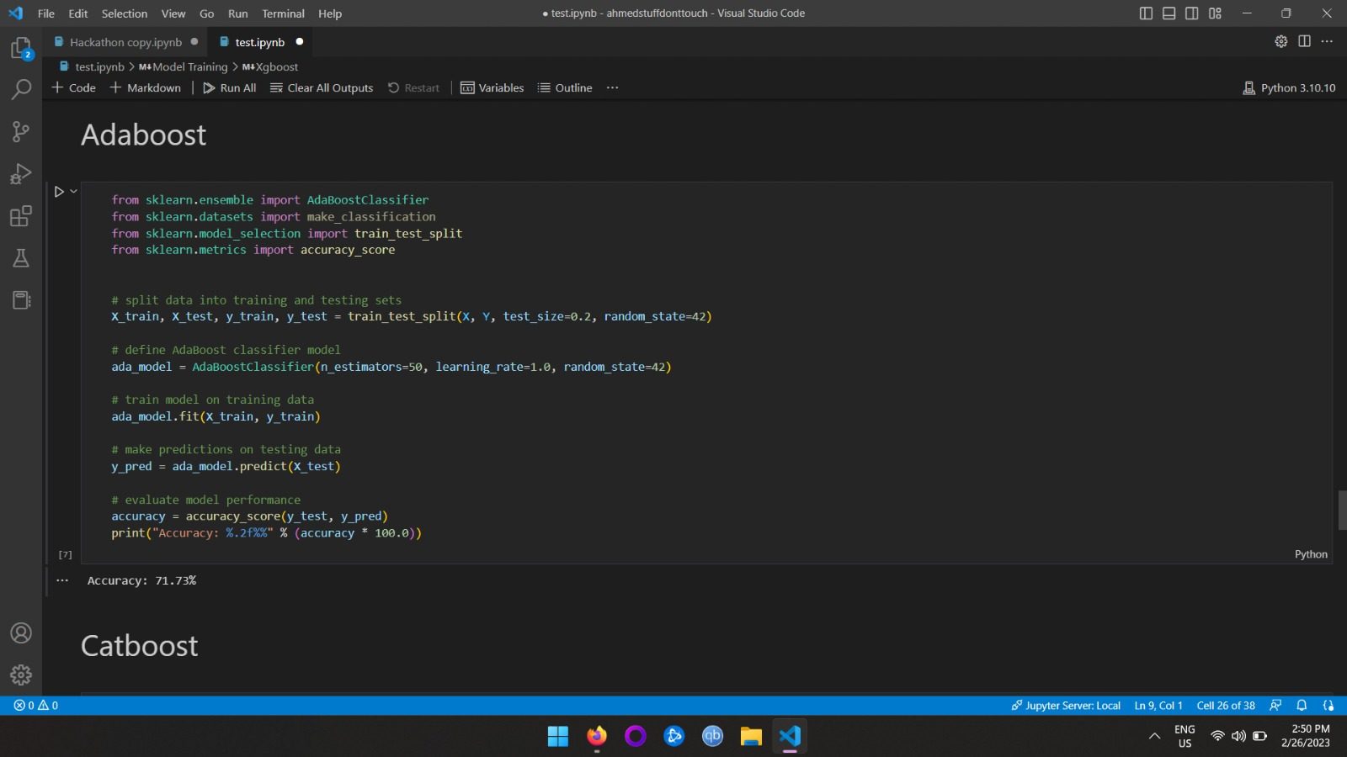
Classifier model-AdaBoost

Slide 13
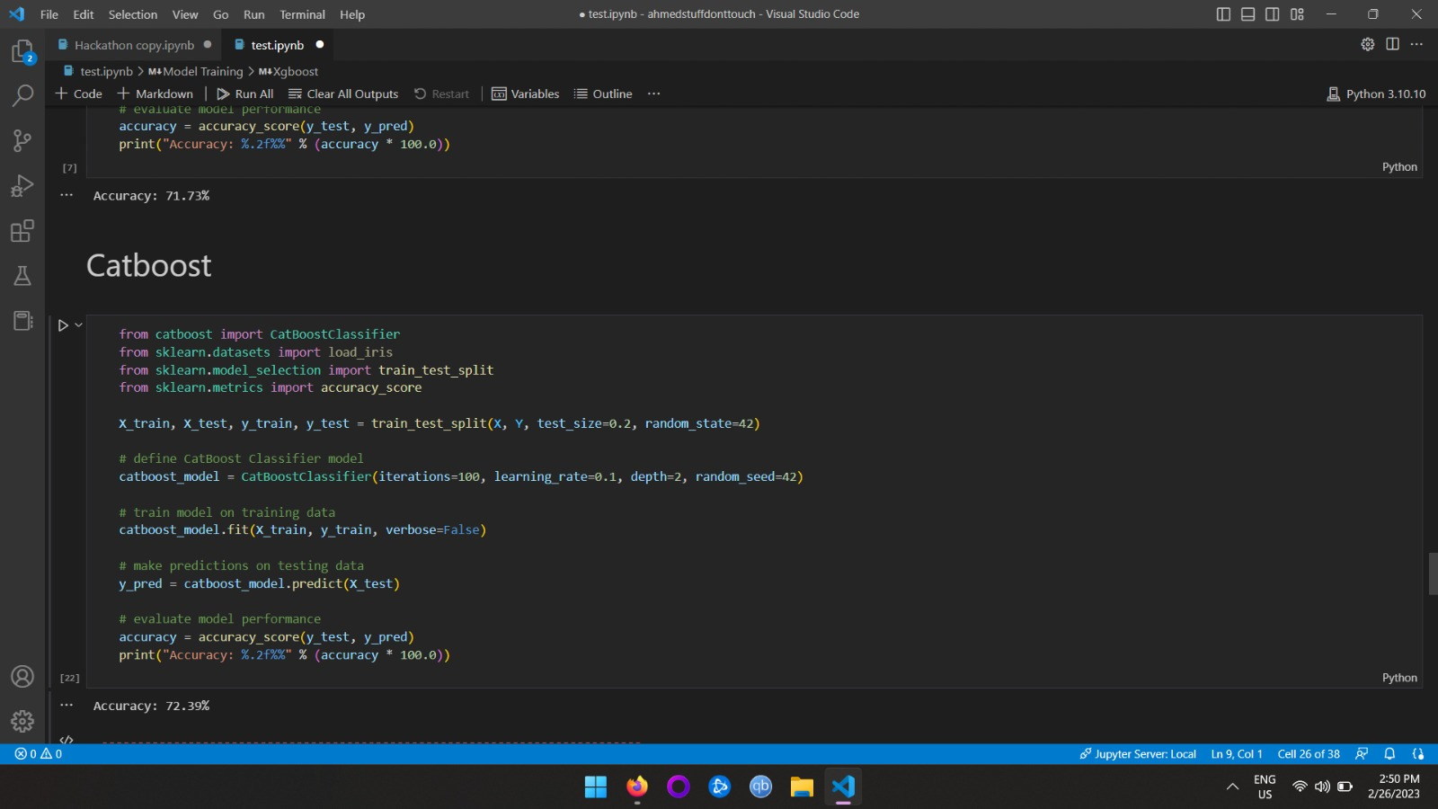
Classifier Model- CatBoost

Slide 14
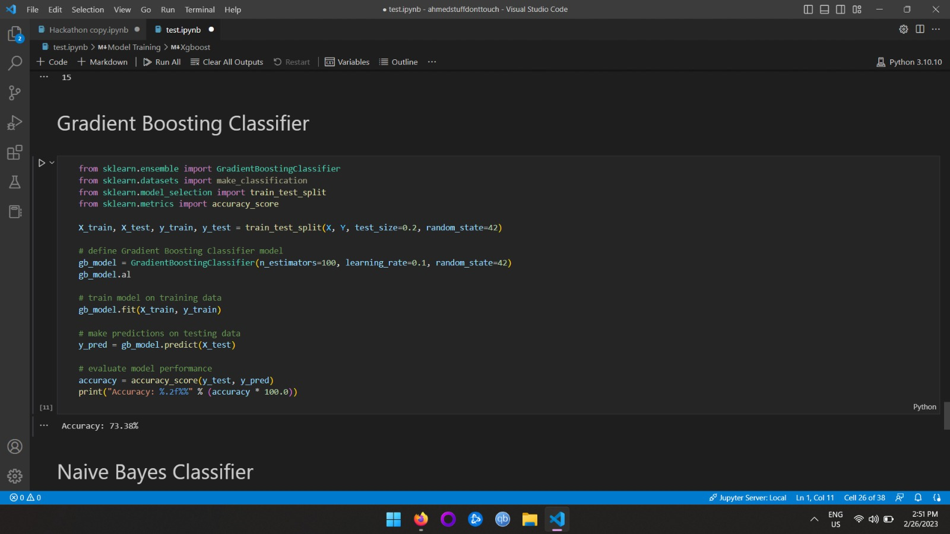
Classifier Model-Gradient Boosting

Slide 15
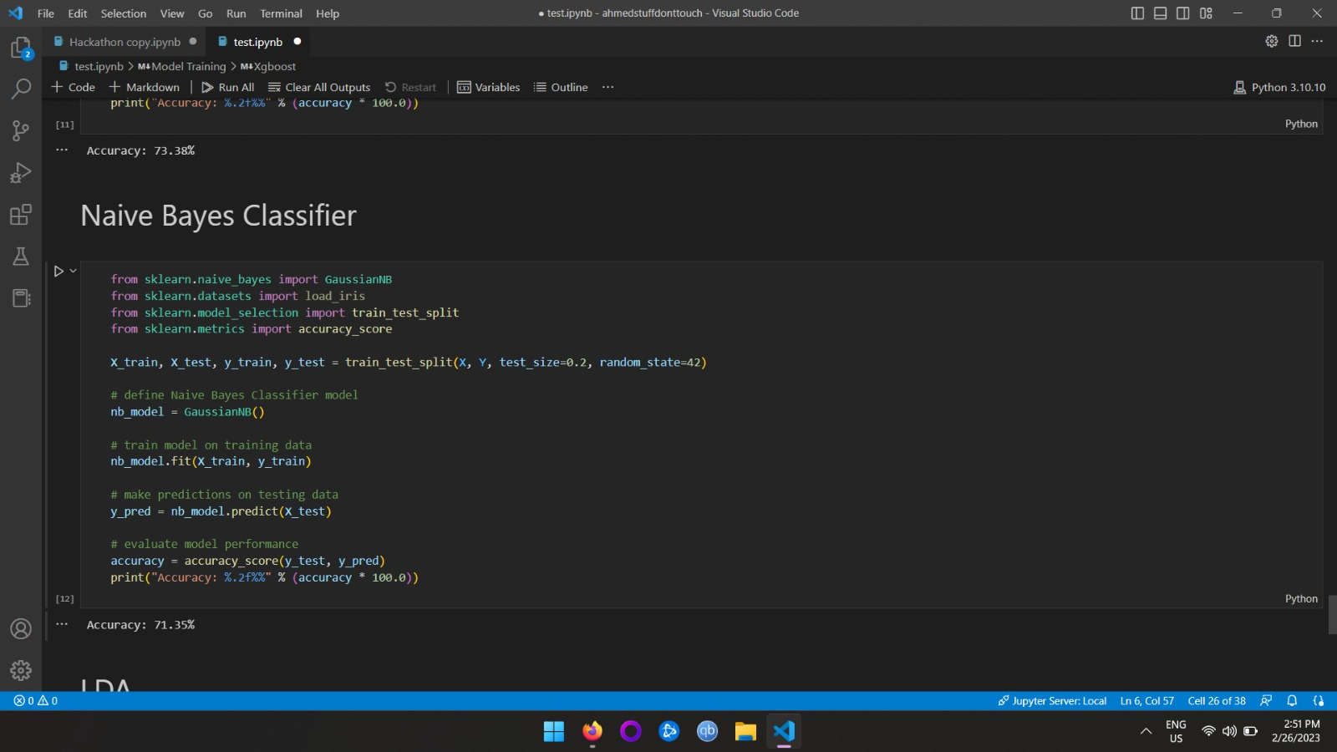
Classifier Model-Naïve Bayes

Slide 16
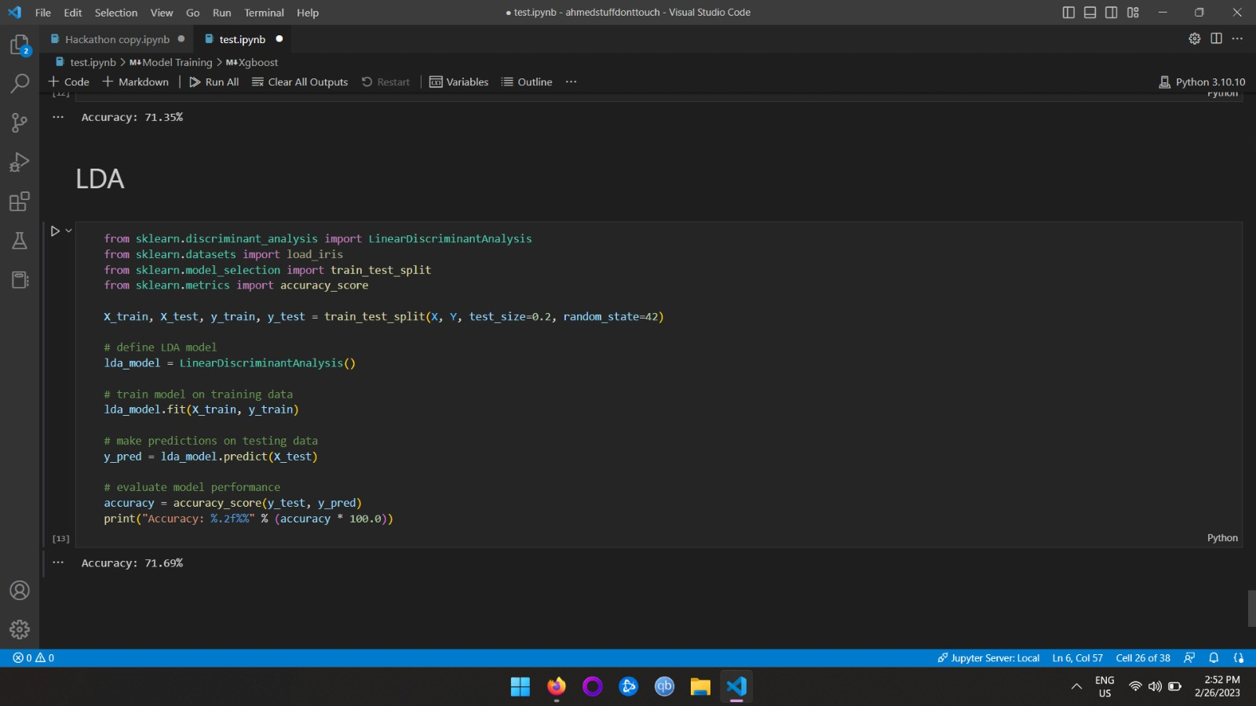
Classifier Model-LDA

Slide 17
Prediction:
The ensembled model was used to predict the final optimized hospitalization days of patients.
Output of Decision Tree Classifier: 85.01%
Output of Gradient Boosting Regression Model: 89.3%
Output of ensembled model: 89.51%

Slide 18
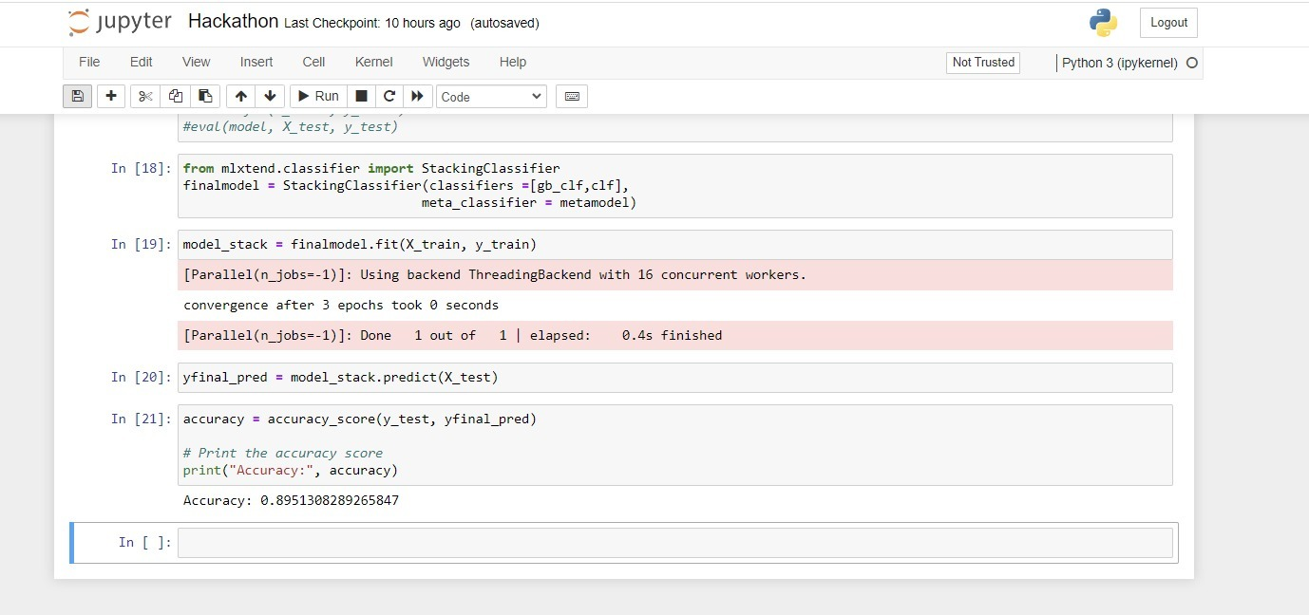
Final Output

